Slide 1
Inter Autonomous System Routing Protocol

Slide 2
BGP(Border Gateway Protocol)
The Border Gateway Protocol version 4, specified in RFC 1771, is the de facto standard interdomain routing protocol in today's Internet.
It is commonly referred to as BGP4 or simply as BGP.
As an inter-autonomous system routing protocol, it provides for routing between autonomous systems (that is, administrative domains).
It is more appropriately characterized as a path vector protocol.
This is because BGP in a router does not propagate cost information (e.g., number of hops to a destination), but instead propagates path information, such as the sequence of ASs on a route to a destination AS.

Slide 3
BGP basics
BGP session: two BGP routers (“peers”) exchange BGP messages:
advertising paths to different destination network prefixes (“path vector” protocol)
exchanged over semi-permanent TCP connections
when AS3 advertises a prefix to AS1:
AS3 promises it will forward datagrams towards that prefix
AS3 can aggregate prefixes in its advertisement
3c
3a
BGP
message
3b
AS3
2c
other
networks
1c
2a
other
networks
1a
2b
1b
AS2
AS1
1d

Slide 4
BGP basics: distributing path information
using eBGP session between 3a and 1c, AS3 sends prefix reachability info to AS1.
1c can then use iBGP do distribute new prefix info to all routers in AS1
1b can then re-advertise new reachability info to AS2 over 1b-to-2a eBGP session
when router learns of new prefix, it creates entry for prefix in its forwarding table.
eBGP session
3a
3b
iBGP session
AS3
2c
other
networks
1c
2a
other
networks
1a
2b
1b
AS2
AS1
1d

Slide 5
BGP
Path Vector Protocol
Incremental Updates
Many options for policy enforcement
Classless Inter Domain Routing (CIDR)
Widely used for Internet backbone
Autonomous systems

Slide 6
BGP route selection
router may learn about more than 1 route to destination AS, selects route based on:
local preference value attribute: policy decision
shortest AS-PATH
closest NEXT-HOP router: hot potato routing
additional criteria

Slide 7
How BGP Works
The whole Internet is a graph of ASs, and each AS is identified by an AS number (ASN).
At any instant of time, a given AS X may, or may not, know of a path of ASs that lead to a given destination AS Z.
As an example, suppose X has listed in its BGP table such a path XY1Y2Y3Z from itself to Z.
This means that X knows that it can send datagrams to Z through the ASs X, Y1, Y2 and Y3, Z.
When X sends updates to its BGP neighbours (i.e., the neighbours in the graph), X actually sends the entire path information, XY1Y2Y3Z, to its neighbours (as well as other paths to other ASs).
If, for example, W is a neighbour of X, and W receives an advertisement that includes the path XY1Y2Y3Z, then W can list a new entry WXY1Y2Y3Z in its BGP table .
However, we should keep in mind that W may decide to not create this new entry for one of several reasons.
For example, W would not create this entry if W is equal to (say) Y2, thereby creating an undesirable loop in the routing; or if W already has a path to Z in its tables, and this existing path is preferable (with respect to the metric used by BGP at W) to WXY1Y2Y3Z ;

Slide 8
BGP Messages
In BGP jargon, the immediate neighbours in the graph of ASs are called peers. BGP information is propagated through the network by exchanges of BGP messages between peers. The BGP protocol defines the four types of messages: OPEN, UPDATE, NOTIFICATION and KEEPALIVE.
OPEN:
BGP peers communicate using the TCP protocol and port number 179. TCP thus provides for reliable and congestion controlled message exchange between peers.
When a BGP gateway wants to first establish contact with a BGP peer , an OPEN message is sent to the peer.
The OPEN message allows a BGP gateway to identify and authenticate itself, and provide timer information.
If the OPEN is acceptable to the peer, it will send back a KEEPALIVE message.

Slide 9
Cont..
UPDATE:
A BGP gateway uses the UPDATE message to advertise a path to a given destination (e.g., XY1Y2Y3Z) to the BGP peer.
The UPDATE message can also be used to withdraw routes that had previously been advertised (that is, to tell a peer that a route that it had previously advertised is no longer a valid route).
● KEEPALIVE:
This BGP message is used to let a peer know that the sender is alive but that the sender doesn't have other information to send.
It also serves as an acknowledgment to a received OPEN message.
● NOTIFICATION:
This BGP message is used to inform a peer that an error has been detected (e. g., in a previously transmitted BGP message) or that the sender is about to close the BGP session.

Slide 10
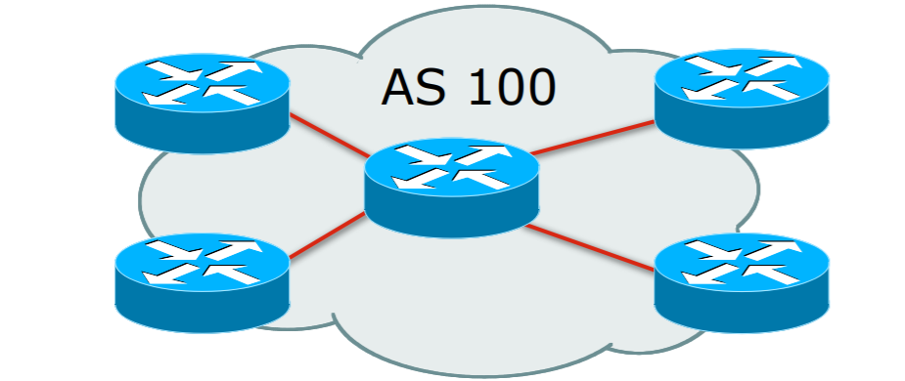
Autonomous System (AS)
Collection of networks with same routing policy
Single routing protocol
Usually under single ownership, trust and administrative control
Identified by a unique 32-bit integer (ASN)

Slide 11
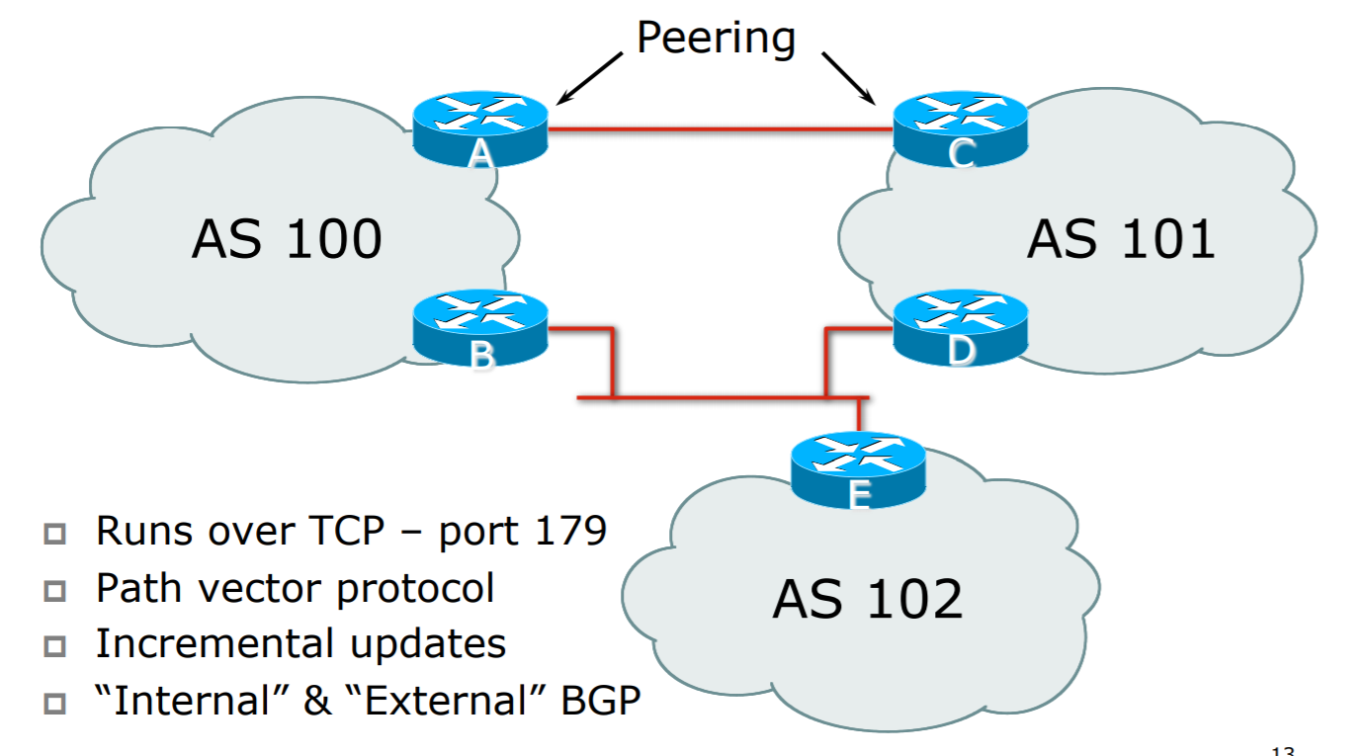
BGP Basics

Slide 12
BGP routing policy
legend:
provider
B
network
X
W
A
customer
C
network:
Y
A,B,C are provider networks
X,W,Y are customer (of provider networks)
X is dual-homed: attached to two networks
X does not want to route from B via X to C
.. so X will not advertise to B a route to C

Slide 13
BGP routing policy (2)
legend:
provider
B
network
X
W
A
customer
C
network:
Y
A advertises path AW to B
B advertises path BAW to X
Should B advertise path BAW to C?
No way! B gets no “revenue” for routing CBAW since neither W nor C are B’s customers
B wants to force C to route to w via A
B wants to route only to/from its customers!

Slide 14
BGP General Operation
Learns multiple paths via internal and external BGP speakers
Picks the best path and installs it in the routing table (RIB)
Best path is sent to external BGP neighbours
Policies are applied by influencing the best path selection

Slide 15
Constructing the Forwarding Table
BGP “in” process
Receives path information from peers
Results of BGP path selection placed in the BGP table
“best path” flagged
BGP “out” process
Announces “best path” information to peers
Best path stored in Routing Table (RIB) if:
Prefix and prefix length are unique, and
Lowest “protocol distance”
Best paths in the RIB are installed in forwarding table (FIB)

Slide 16
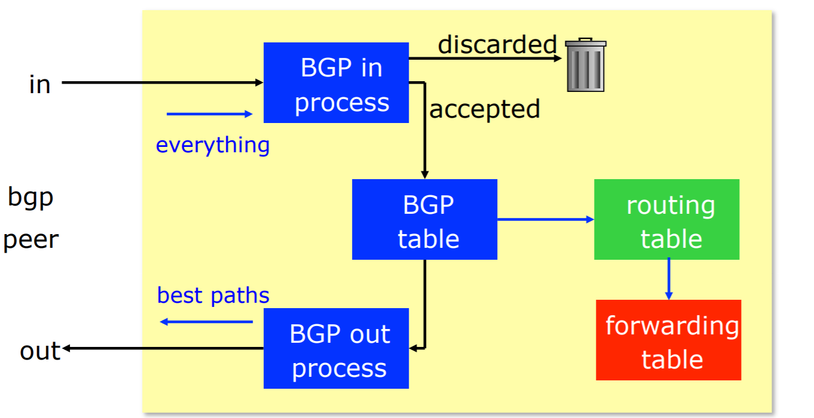

Slide 17
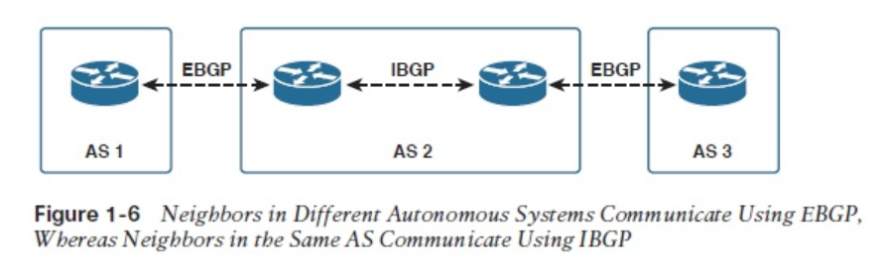
eBGP & iBGP
BGP is used
Internally (iBGP)
Externally (eBGP)
If a BGP session is established between two neighbours in different autonomous systems, the session is external BGP (EBGP), and if the session is established between two neighbors in the same AS, the session is internal BGP (IBGP).

Slide 18

IBGP &EBGP
Multiple routers usually exist within an AS, so IBGP is necessary whenever BGP advertised information must be passed within a given AS.
In Figure 1-6, for instance, the combination of EBGP and IBGP sessions makes it possible for the router in AS1 to advertise a route to the router in AS3.
Traditionally, IBGP is associated with transit autonomous systems such as AS2 in Figure 1-6.
A stub AS usually runs EBGP at one or more gateway routers only, and routes packets to and from the gateway routers via an IBGP.

Slide 19
Hierarchical Routing Protocol
BGP uses hierarchical routing protocol:
aggregate routers into regions, “ autonomous systems ” (AS)
routers in same AS run same routing protocol
“intra-AS” routing protocol :
routers in different AS can run different intraAS routing protocol
gateway router:
at “edge” of its own AS
has link to router in another AS

Slide 20
Interconnected ASes
3c
3a
2c
3b
AS3
2a
1c
2b
AS2
1a
1b
1d
AS1
forwarding table configured by both intra- and inter-AS routing algorithm
intra-AS sets entries for internal dests
inter-AS & intra-AS sets entries for external dests
Intra-AS
Routing
algorithm
Inter-AS
Routing
algorithm
Forwarding
table

Slide 21
Inter-AS tasks
suppose router in AS1 receives datagram destined outside of AS1:
router should forward packet to gateway router, but which one?
AS1 must:
learn which dests are reachable through AS2, which through AS3
propagate this reachability info to all routers in AS1
job of inter-AS routing!
3c
3a
3b
AS3
2c
other
networks
1c
2a
other
networks
1a
2b
1b
AS2
AS1
1d

Slide 22
Example: setting forwarding table in router 1d
suppose AS1 learns (via inter-AS protocol) that subnet x reachable via AS3 (gateway 1c), but not via AS2
inter-AS protocol propagates reachability info to all internal routers
router 1d determines from intra-AS routing info that its interface I is on the least cost path to 1c
installs forwarding table entry (x,I)
…
x
3c
3a
3b
AS3
2c
other
networks
1c
2a
other
networks
1a
2b
1b
AS2
AS1
1d

Slide 23
Example: choosing among multiple ASes
now suppose AS1 learns from inter-AS protocol that subnet x is reachable from AS3 and from AS2.
to configure forwarding table, router 1d must determine which gateway it should forward packets towards for dest x
this is also job of inter-AS routing protocol!
…
x
3c
……
3a
3b
AS3
2c
other
networks
1c
2a
other
networks
1a
2b
1b
AS2
AS1
1d
?

Slide 24
Example: choosing among multiple ASes
now suppose AS1 learns from inter-AS protocol that subnet x is reachable from AS3 and from AS2.
to configure forwarding table, router 1d must determine towards which gateway it should forward packets for dest x
this is also job of inter-AS routing protocol!
hot potato routing: send packet towards closest of two routers.
use routing info
from intra-AS
protocol to determine
costs of least-cost
paths to each
of the gateways
determine from
forwarding table the
interface I that leads
to least-cost gateway.
Enter (x,I) in
forwarding table
learn from inter-AS
protocol that subnet
x is reachable via
multiple gateways
hot potato routing:
choose the gateway
that has the
smallest least cost

